Slide 1
Hello and Welcome!
PSYC234: Statistics: from association to modelling causality
Dr Amy Atkinson
Lecturer in Developmental Psychology
amy.atkinson@lancaster.ac.uk

Slide 2
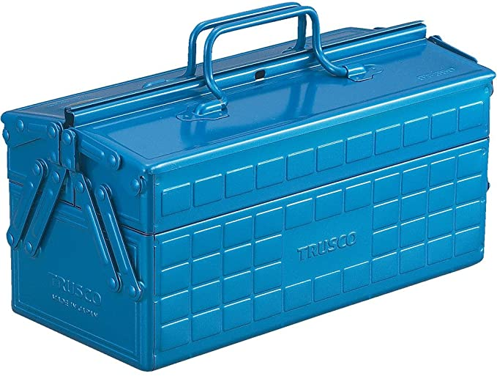
Your statistics toolbox
Soon you will have to apply what you’ve learned to your dissertation
One issue: there are relatively common situations where these tests aren’t appropriate… what then?!
Linear regression
Correlation
ANOVA
T-test

Slide 3
The plan
My aim: to add a few final statistical tests to your toolbox for when the statistical test you’ve learned about might not be appropriate
Week 5
(This week)
The Binomial Test
A situation where t-tests aren’t appropriate

Slide 4
Lecture 5 – Part 2 The Binomial test
PSYC234: Statistics: from association to modelling causality
Dr Amy Atkinson
Lecturer in Developmental Psychology
amy.atkinson@lancaster.ac.uk

Slide 5
Learning objectives
To understand what the binomial test is and when to use it
To understand how to conduct the binomial test in R and interpret the output

Slide 6
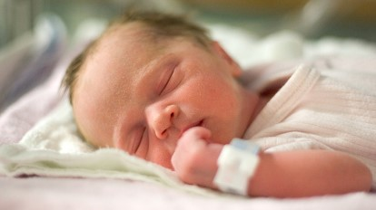
Let’s think back to the one-sample t-test
You are a researcher interested in whether babies born in Germany weigh more than babies born in the UK.
Let’s assume the following are true:
The NHS keeps good records of birth weights in the UK, and that the average birth weight in the UK in 2020 was 3350g.
The health authorities in Germany do not keep good records of birth weights.
Notes:
Is the mean of a population significantly different from a known value?

Slide 7
What do we do?
Participant | Birth weight (g)
1 | 3004
2 | 3052
3 | 3067
4 | 4063
5 | 2134
6 | 2356
7 | 4356
8 | 3567
9 | 3432
10 | 3245
11 | 1467
12 | 2345
13 | 4532
14 | 4352
15 | 2453
16 | 2343
17 | 3453
18 | 3428
19 | 2344
20 | 4353
You could collect birth weights from a sample of babies born in Germany and compare this to the known average in the UK (3350g).
Is the mean of the sample significantly different from a known value?
One-sample t-test!
Babies born in Germany
Mean = 3167.30g

Slide 8

Another scenario…
Is the moon made of cheese?
Yes
No
ID | Answer | ID | Answer
1 | No | 8 | No
2 | No | 9 | No
3 | Yes | 10 | No
4 | No | 11 | No
5 | No | 12 | No
6 | No | 13 | No
7 | No | 14 | No
Does the proportion of participants answering the question correctly differ from the chance guessing rate?

Slide 9
Another scenario…
Does the proportion of participants answering the question correctly differ from the chance guessing rate?
ID | Answer | ID | Answer
1 | No | 8 | No
2 | No | 9 | No
3 | Yes | 10 | No
4 | No | 11 | No
5 | No | 12 | No
6 | No | 13 | No
7 | No | 14 | No
How many participants answered the question correctly?
Correct (“No”) = 13/14 = 0.93

Slide 10
Another scenario…
Does the proportion of participants answering the question correctly differ from the chance guessing rate?
What is chance guessing rate?
ID | Answer | ID | Answer
1 | No | 8 | No
2 | No | 9 | No
3 | Yes | 10 | No
4 | No | 11 | No
5 | No | 12 | No
6 | No | 13 | No
7 | No | 14 | No
How many participants answered the question correctly?
Correct (“No”) = 13/14 = 0.93
Incorrect (“Yes”) = 1/14 = 0.07
2 possible answers (yes/no)
So chance = 50%
Expressed as a proportion, this is 0.5
To convert a percentage to a proportion, divide by 100 = 50/100 = 0.5

Slide 11
Can we use the one-sample t-test?
Proportion correct in sample = 0.93
Chance guessing rate (proportion) = 0.5
One sample t-test: Is the mean of the sample significantly different from a known value?
Issue: we can’t calculate a mean value for the sample – we have a proportion who answered correctly
So, we can’t use a one-sample t-test…
What can we use?!

Slide 12
The Binomial Test
The binomial test compares a sample proportion to a known value, such as…
Does a sample proportion differ significantly from a known value?
Known value may be theoretical (e.g. based on chance) or known data about the world (e.g. 26% people die from this disease)
Proportion correct in sample = 0.93
Chance guessing rate (proportion) = 0.5

Slide 13
The Binomial Test: Other examples
You notice that a lot of the insects in your garden are ants. You work out that 564 out of 712 insects are ants. You hear on a TV show that on average, 64% of insects in UK gardens are ants. Is the proportion of insects that are ants in your garden larger than UK average?
Proportion of sample that are ants are: 564/712 = 0.79
Known value (expressed as a proportion)= 0.64
You develop a new vaccine for an illness and give this to 1,000 people - 32/1000 given the vaccine get the illness within a year. You know that approximately 10% of unvaccinated people (or 0.1 expressed as a proportion) get the illness every year. Is the proportion of vaccinated people getting the illness lower than the known value for unvaccinated people?
Proportion of sample that get the illness: 32/1000 = 0.03
Known value (expressed as a proportion)= 0.10
Does a sample proportion differ significantly from a known value?

Slide 14
Assumptions of the binomial test

Slide 15
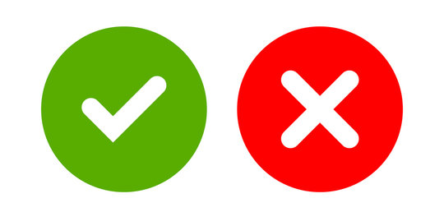
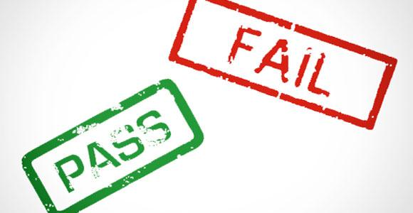
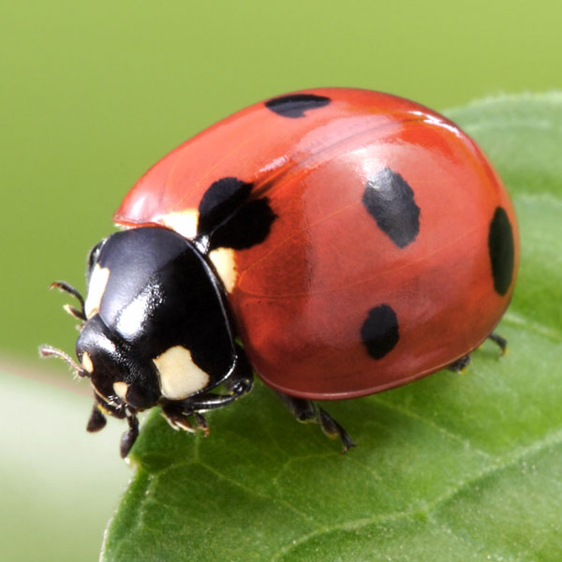

1. The outcome is dichotomous: There are only two possible outcomes
Correct/Incorrect
Pass/fail
Has SEND/does not have SEND
Is a ladybird/is not a ladybird

Slide 16
2. The outcome can be specified as success or failure
Success is the category we are calculating the proportion for. Failure is the other category
Sometimes this makes sense and fits well with the outcome.
Does the proportion of participants answering the question correctly differ from the chance guessing rate?
Success = correct
Failure = incorrect

Slide 17

Sometimes it is less obvious…
You notice that a lot of the insects in your garden are ants.
You work out that 564 out of 712 insects are ants.
You hear on a TV show that on average, 64% of insects in UK gardens are ants.
Is the proportion of insects that are ants in your garden larger than UK average?
Success: Ant
Failure: Not ant

Slide 18
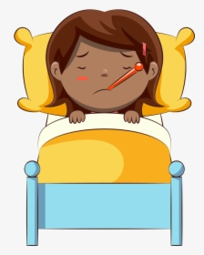
… and sometimes it is counterinitiative
You develop a new vaccine for an illness and give this to 1,000 people - 32/1000 given the vaccine get the illness within a year.
You know that approximately 10% of unvaccinated people (or 0.1 expressed as a proportion) get the illness every year.
Is the proportion of vaccinated people getting the illness lower than the known value for unvaccinated people?
Success: Get illness
Failure: Do not get illness

Slide 19

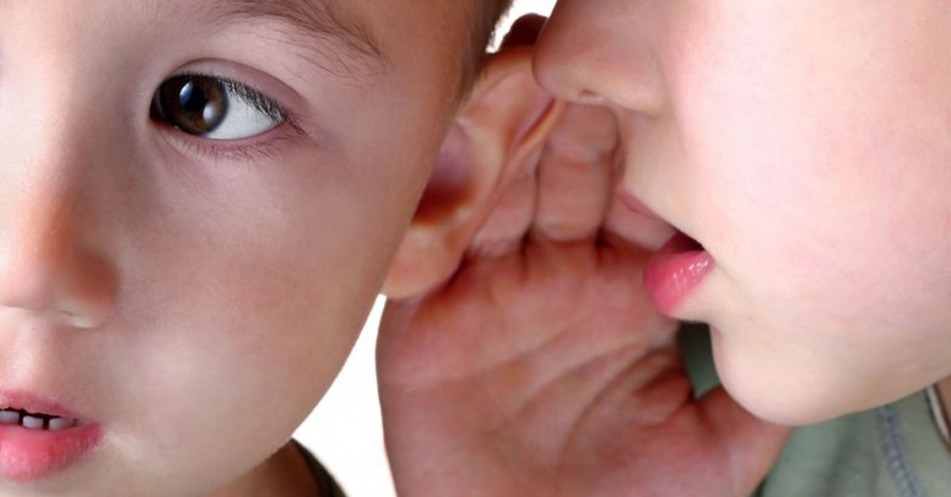
3. Each trial is independent
Independent
Not independent

Slide 20
4. The probability of ‘success’ remains the same on every trial
All participants are given the same version of the question:
Two versions of the question:
Is the moon made of cheese?
Yes
No
Is the moon made of cheese?
Yes
No
Is the moon made of cheese?
Yes
No, it never has been
No, but it used to be
Outcome 1: Correct = b
Outcome 2: Incorrect = a
Outcome 1: Correct = b
Outcome 2: Incorrect = a or c

Slide 21
Running the binomial test in R

Slide 22

How do I conduct a binomial test in R?
Function to run the binomial test
Number of successes (e.g. correct)
Known value, here expressed as a proportion (here chance guessing rate)
Number of trials in total

Slide 23
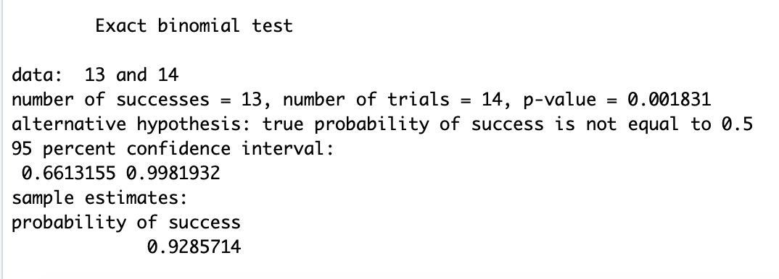
R output
Number of successes (e.g. correct)
Total number of trials
p-value
95% confidence interval around the probability of success
Known value you specified
Probability of success, calculated by doing 13/14

Slide 24
How do I interpret the p-value?
p ≤ .05 = The observed proportion differs significantly from the known value
p > .05 = The observed proportion does not differ significantly from the known value

Slide 25
I have a significant effect… In what direction is the effect?
Is the probability of success higher or lower than the known value?
The proportion of children answering the question correctly is significantly higher than the chance guessing rate

Slide 26
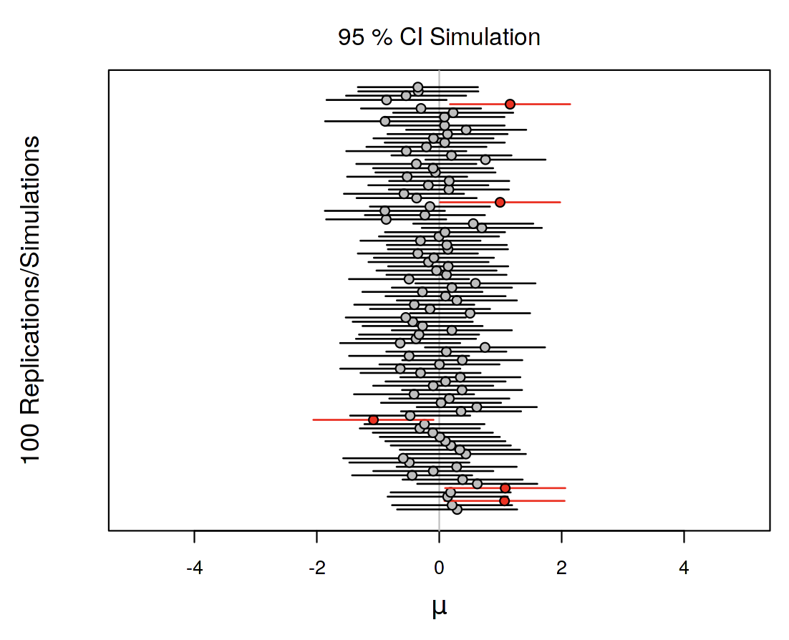
What does the 95% confidence interval tell us?
If we repeat the sampling method many many times and compute a 95% confidence interval, 95% of the intervals would contain the true value in the population.
Range that is likely to contain the true value
True proportion of participants who answer the question correctly is likely to be between 0.66 and 1.00

Slide 27
Reporting in APA format
A binomial test was conducted to determine whether the proportion of participants answering the question correctly differed significantly from chance guessing rate. This revealed that that the proportion of participants answering the question correctly (93%; 95% confidence interval = 66-100%) was significantly higher than the chance guessing rate (50%; p = 0.002).

Slide 28
Post-lecture activities Complete ideally before WBA
Some activities to help you structure your independent study time
Download from Moodle
Optional, but recommended

Slide 29
Thank you for listening!
Please post any questions about the binomial test on the discussion board or the anonymous Qualtrics link (“The Binomial Test: Post questions anonymously” link)

